Slide 1
Tech Interview Prep:
AuthN vs. AuthZ and SQL Injection Defense
Section 1: Authentication vs. Authorization
Section 2: Defending Against SQL Injection
Section 3: Synthesis & Takeaways
Name: Dara Sen
Class: AD371 (Application architecture)

Slide 2
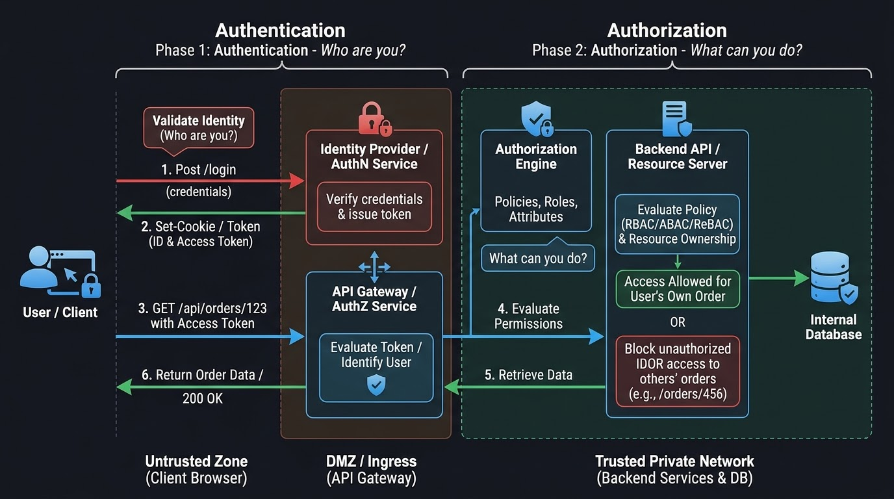
Section 1: Authentication vs. Authorization

Slide 3
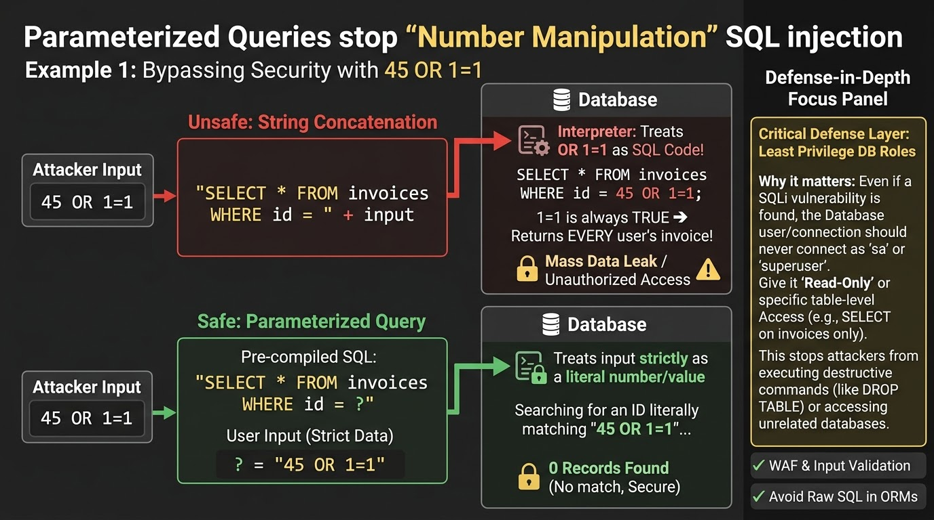
Section 2: Defending Against SQL Injection

Slide 4
Section 3: Synthesis & Takeaways
Authentication vs. Authorization
Parameterized queries
Add Application Firewalls, least-privilege database roles with RLS, input validation

